Slide 1


David Marquez
12/26/2025

Slide 2

Outline
Executive Summary
Introduction
Methodology
Results
Conclusion
Appendix

Slide 3
Executive Summary
Summary of methodologies
Data Collection using API and Web scraping.
Data Wrangling.
EDA with Data Analysis, Data Visualization and SQL.
Interactive map with Folium library.
Interactive dashboard with Plotly library.
Machine Learning predictive model.
Summary of all results
EDA.
Interactive map and dashboard.
Predictive model.

Slide 4
Introduction
SpaceX's Falcon 9 rocket has revolutionized space travel by introducing reusable rockets. However, predicting whether a rocket will successfully land after launch remains a complex task. Multiple factors, such as payload mass, orbit, launch site and others, could affect the landing outcome. This capstone project aims to analyze and develop a predictive model to determine successful or failed landings.
We can determine the landing outcome by addressing the following questions:
What are the main features that influence successful landings?
Is there an evolution in successful landings or do failures continue?
Do external factors affect the landing outcome?
Can we determine the landing outcome using a predictive model?

Slide 5

Section 1

Slide 6
Methodology
Executive Summary
Data collection methodology:
API SpaceX with multiple endpoints.
Web scraping from Wikipedia.
Perform data wrangling:
Drop NaN Values.
Generate one-hot encoding for categorical features.
Perform exploratory data analysis (EDA) using visualization and SQL:
Analyzing launch facilities and orbits.
Visualizing the relationship between variables such as Launch Site, Flight Number, Payload Mass and Orbit.
Perform interactive visual analytics using Folium and Plotly Dash:
Total Success Launches by Site.
Correlation between Payload Mass and Success for all Sites.
Perform predictive analysis using classification models:
Build, tune, evaluate classification models.

Slide 7
Data Collection
The data was collected by API SpaceX: https://api.spacexdata.com/v4, specifically of:
FlightNumber
Date
BoosterVersion
PayloadMass
Orbit
LaunchSite
Outcome
Flights
GridFins
Reused
Legs
LandingPad
Block
ReusedCount
Serial
Longitude
Latitude
Web scraping from Wikipedia URL (as of 9th June 2021): https://en.wikipedia.org/w/index.php?title=List_of_Falcon_9_and_Falcon_Heavy_launches&oldid=1027686922 obtaining:
Flight No
Launch site
Payload mass
Orbit
Customer
Boosterlanding
Payload
Launch outcome
Version Booster
Date
Time

Slide 8
Data Collection – SpaceX API
Collect the data from SpaceX API to obtain a response.
Become the response object into json file.
Transform json file in a dataset and clean the columns that doesn’t add value.
Use functions to extract from some features specific data inside them.
GitHub Notebook URL:https://github.com/demarquezs/IBM_DS_Capstone_Project/blob/master/notebooks/Data%20Collection%20and%20Data%20Wrangling.ipynb
Request to SpaceX API
Transform the response into a json file
Transform json file into a dataset and clean the columns
From the previous extraction, get specific data inside the columns

Slide 9
Data Collection - Scraping
Request to Wikipedia URL to obtain response code 200.
Create a beautiful soup object from HTML response, collect relevant column names from header and iterate through the “th” elements to extract the columns.
Create an empty dictionary with the columns obtained, delete one who don’t add value.
Create empty lists and fill them with functions who scrapping the information, then add to dictionary. Then, Become a dictionary into a dataframe.
GitHub Notebook URL: https://github.com/demarquezs/IBM_DS_Capstone_Project/blob/master/notebooks/Data%20Collection%20with%20Webscrapping.ipynb
Request to Wikipedia URL
Beatiful soup object, collect header names and iterate
Create an empty dictionary and fill it with scrapping funcions
Becoma a dictionary into a dataframe

Slide 10
Data Wrangling
NaN/Null Values
From the dataset obtained in Data Collection, search for NaN/Null values.
For column Payload Mass calculate mean value.
Replace NaN/Null values with the mean calculated previously.
For Landing Pad drop the NaN values, because this columns has string values.
Search for NaN/Null values.
One hot Encoding
Create a dataframe with only categorical features.
Transform categorical features to numerical using get dummies.
Change datatype columns to float64.
Create a dataframe only categorical
Calculate mean values of PayloadMass
Transform categorical into numerical
Replace NaN/Null values with the mean calculated
Change data type to float 64
Drop NaN values for LandingPad
GitHub Notebook URL: https://github.com/demarquezs/IBM_DS_Capstone_Project/blob/master/notebooks/Data%20Collection%20and%20Data%20Wrangling.ipynb

Slide 11
EDA with Data Visualization
Chart Summary:
Flight Number vs. Payload Mass (hue Class)
Flight Number vs Launch Site (hue Class)
These graphics are to verify if Flight Number can affect successful landing considering the features Payload Mass and Launch Site.
Launch Site vs Payload Mass (hue Class) scatterplot and bar plot
These graphics are to verify if features Payload Mass and Launch Site can affects over successful landing.
Orbit vs Success Count (hue Class)
Orbit vs Success Mean
Orbit vs Flight Number
Flight Number vs Orbit (hue Class)
Orbit vs Payload Mass
Payload Mass vs Orbit (hue Class)
These ones is for see what orbit have the better success landing considering features Payload Mass, Launch Site and Flight Number.
Year vs Success Mean:
We notice the success has increased over the years.
GitHub Notebook URL:
https://github.com/demarquezs/IBM_DS_Capstone_Project/blob/master/notebooks/EDA.ipynb

Slide 12
EDA with SQL
EDA SQL Summary:
Names of the unique launch sites in the space mission.
5 records where launch sites begin with the string 'KSC’.
Total payload mass carried by boosters launched by NASA (CRS).
Average payload mass carried by booster version F9 v1.1.
Date where the successful landing outcome in drone ship was achieved.
Names of the boosters which have success in ground pad and have payload mass greater than 4000 but less than 6000.
Total number of successful and failure mission outcomes.
Names of the booster_versions which have carried the maximum payload mass.
Records which will display the month names, successful landing_outcomes in ground pad ,booster versions, launch_site for the months in year 2017.
Rank of count of landing outcomes such as Failure (drone ship) or Success (ground pad)) between the date 2010-06-04 and 2017-03-20, in descending order
GitHub Notebook URL: https://github.com/demarquezs/IBM_DS_Capstone_Project/blob/master/notebooks/EDA_SQL.ipynb

Slide 13
Build an Interactive Map with Folium
Map Objects Summary
Circle on NASA Johnson Space Center at Houston, Texas.
Circle on each launch site and show the names.
White marker with green or red center to identify for success or failed launches.
Circle on coastline, show the distance and a line from some launch site.
Line between a some launch site to its closest city, railway, and highway.
These objects are added to identify geographical patterns and understand better the context problem.
GitHub Notebook URL: https://github.com/demarquezs/IBM_DS_Capstone_Project/blob/master/notebooks/Interactive_Map.ipynb

Slide 14
Build a Dashboard with Plotly Dash
Plot Summary
Dropdown to select the launch site.
Pie Chart with success launch by launch site selected, include all.
Range slider to define the payload mass range for the next chart.
Scatter plot showing success or failed launch per boost version, by launch site selected and payload mass range defined.
These interactive items give us more information about how different features simultaneously could affects successful landing.
GitHub Code URL:
https://github.com/demarquezs/IBM_DS_Capstone_Project/blob/master/src/spacex_dash_app.py

Slide 15
Predictive Analysis (Classification)
Load dataframe and define X and Y data
We load the dataframe from URL https://cf-courses-data.s3.us.cloud-object-storage.appdomain.cloud/IBM-DS0321EN-SkillsNetwork/datasets/dataset_part_2.csv .
Define X varible and Y (goal) variable into numpy array.
Standardize X and reassign it to the variable X.
Split X data in training (80%) and testing (20%)
Create models: Logistic Regression, Support Vector Machine, Decision Tree Classifier, and K Nearest.
Evaluate them with their accuracy and confusion matrix-
With the data obtained previously, determine the best model.
Save (best) model object.
GitHub Notebook URL: https://github.com/demarquezs/IBM_DS_Capstone_Project/blob/master/notebooks/SpaceX_Machine_Learning_Prediction.ipynb
GitHub Model URL:https://github.com/demarquezs/IBM_DS_Capstone_Project/blob/master/models/spacex_classifier.pkl
Standardize X and split data into training and testing
Create and evaluate differents models
Determine the best model
Save the model

Slide 16
Results
With EDA we found that:
KSC LC-39A and VAFB SLC 4E has the best success rate
The best orbits for successful landing are SSO, VLEO, MEO, and GEO
The successful landing has increased over the years.
Payload Mass doesn’t affect the success rate
From Interactive Dashboard we notice:
KSC LC-39A is the best site.
FT is the best boost version for lower values of Payload Mass
We found that Logistic Regression is the best predictive model.

Slide 17

Section 2

Slide 18
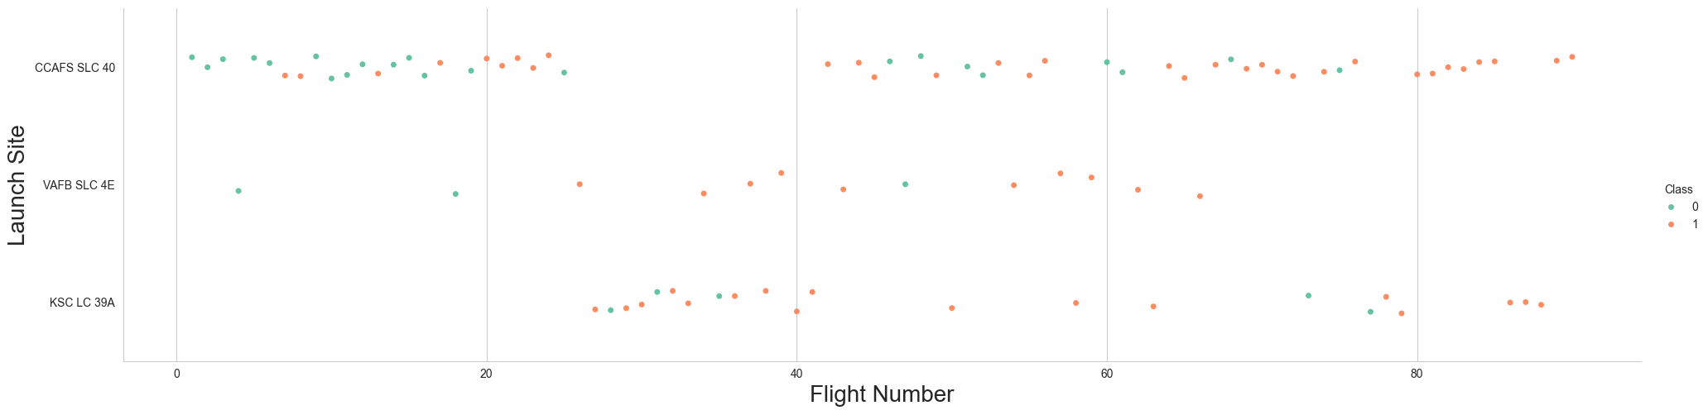
Flight Number vs. Launch Site
We see that at all sites, as the flight number increases, the successful landings increase. Another insight is that CCAFS SLC-40 was the test site; we can see at the other sites that there are fewer failed landings.

Slide 19
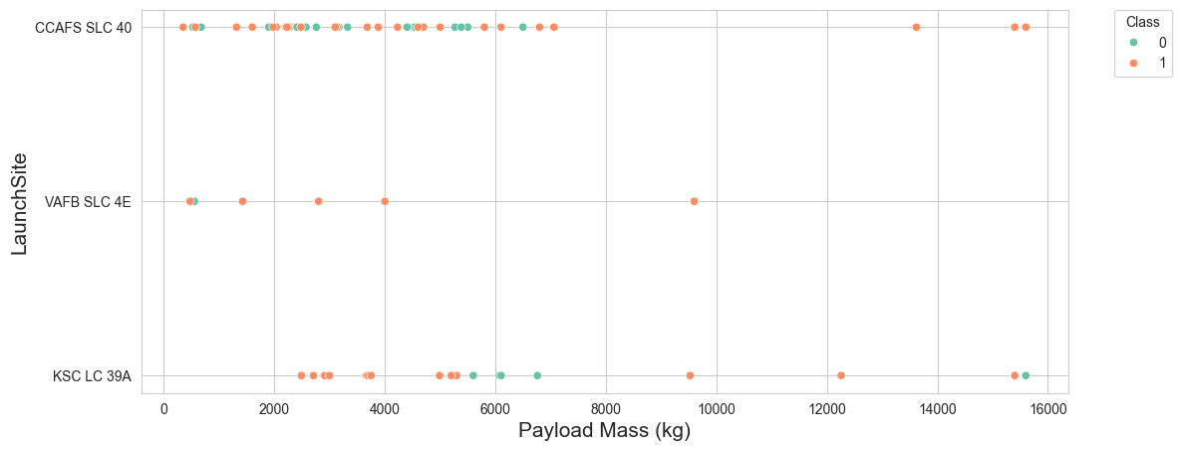
Payload vs. Launch Site
We see that the payload mass doesn't have a relationship with the launch site in terms of increasing the quantity of successful landings.

Slide 20
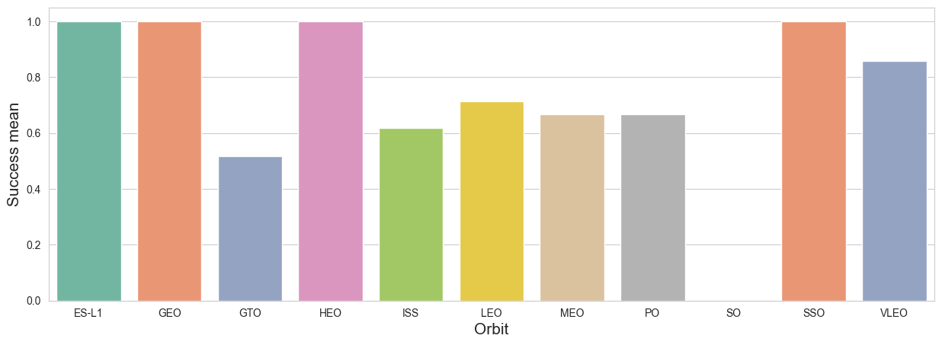
Success Rate vs. Orbit Type
There are a high number of success landing un VLEO and SSO orbits. HEO and ES-L1 could be a good orbits but we need more information.

Slide 21
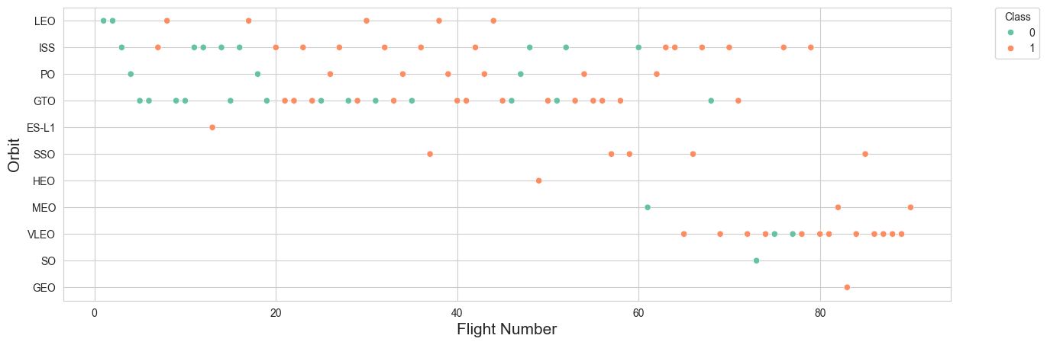
Flight Number vs. Orbit Type
VLEO have better success landing in fewer Flight Number. LEO have the better in major. SSO don’t has failed landing. HEO only has one flight number and it’s successful. The other orbits have a mix of results.

Slide 22
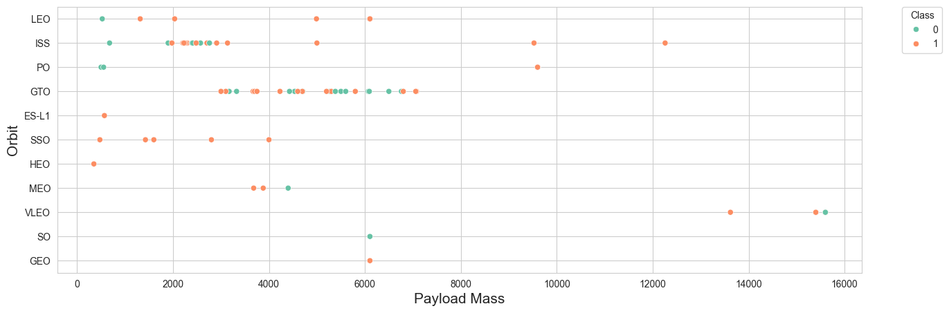
Payload vs. Orbit Type
For LEO and ISS when the payload mass has incremented, the successful landing too. For SSO has successful landing in lower payload mass, but we don’t know what happen if it be increased.

Slide 23
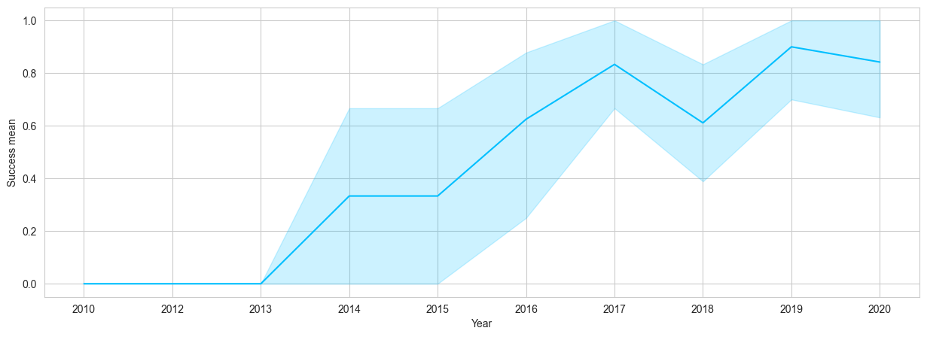
Launch Success Yearly Trend
We can observe that the success rate since 2013 kept increasing till 2020.

Slide 24
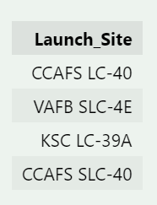
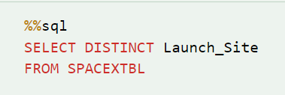
All Launch Site Names
We use DISTINCT to find the Site Names.

Slide 25
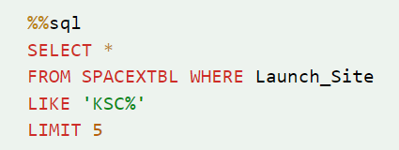
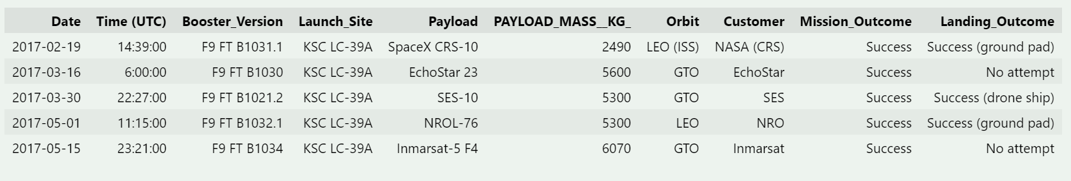
Launch Site Names Begin with 'KSC'
We use LIKE to only found KSC records and LIMIT 5 to find only five launch sites.

Slide 26
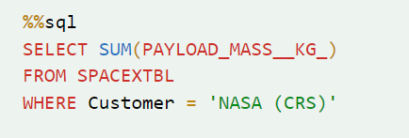
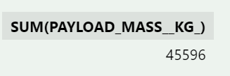
Total Payload Mass
To find the total payload mass we use SUM function and use WHERE to define only for costumer NASA (CRS).

Slide 27
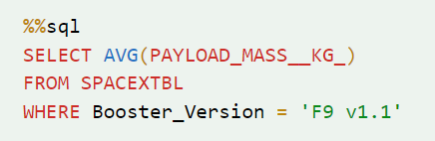
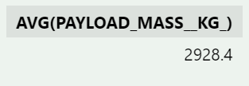
Average Payload Mass by F9 v1.1
To find the average payload mass we use AVG function and use WHERE to define only for Booster version ‘F9 v1.1.

Slide 28
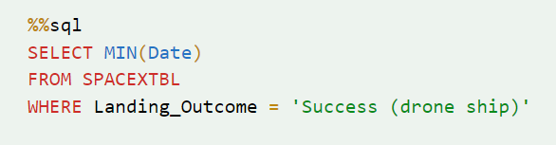
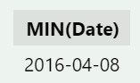
First Successful Ground Landing Date
To find the first date that have successful lading we use MIN function over Date column and use WHERE to define only for landing outcome ‘Success (drone ship)’

Slide 29
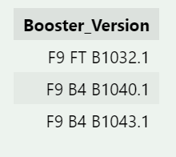
Successful Drone Ship Landing with Payload between 4000 and 6000
We only SELECT Booster version, and use WHERE command on Landing Outcome equal to ‘Success (ground pad)’ for only successful landing. Then, use AND command to define range between 4000 and 6000.

Slide 30
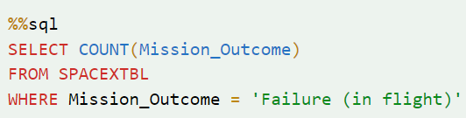
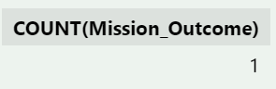
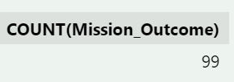
Total Number of Successful and Failure Mission Outcomes
We make two queries, one counting Mission Outcome equal to ‘Failure (in flight)’ that it means failed landing, other to count values ‘Success’ and ‘Success (payload status unclear)’, that they mean successful landing

Slide 31
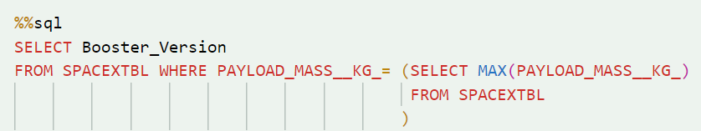
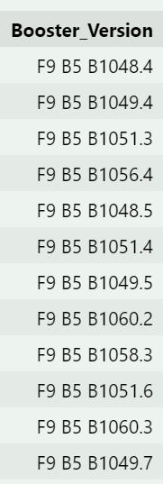
Boosters Carried Maximum Payload
We make subquery to find MAX payload mass, and then make a query to find that value for every Booster version

Slide 32
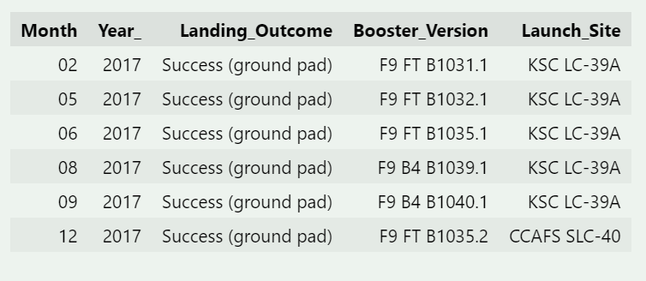
2017 Launch Records
For obtain the month we extract from column ‘Date’. With the command WHERE define the year 2017 and landing outcome = ‘Success (ground pad)’.

Slide 33
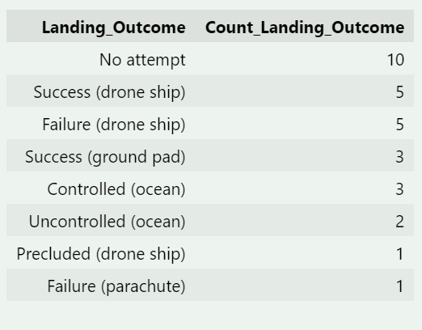
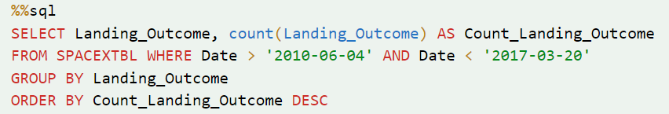
Rank Landing Outcomes Between 2010-06-04 and 2017-03-20
First, we count Landing outcome on the dates specified, then use the GROUP BY command, and fin finally use the ORDER BY command to see the records in descendant order.

Slide 34

Section 3

Slide 35
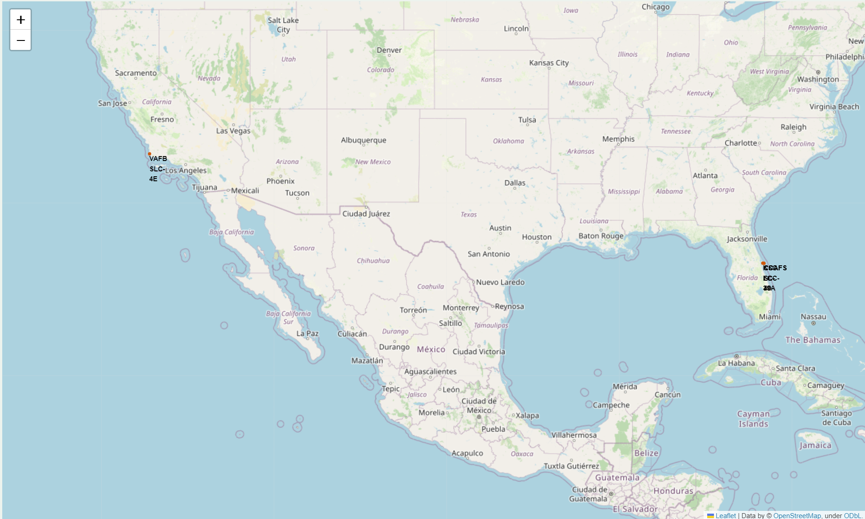
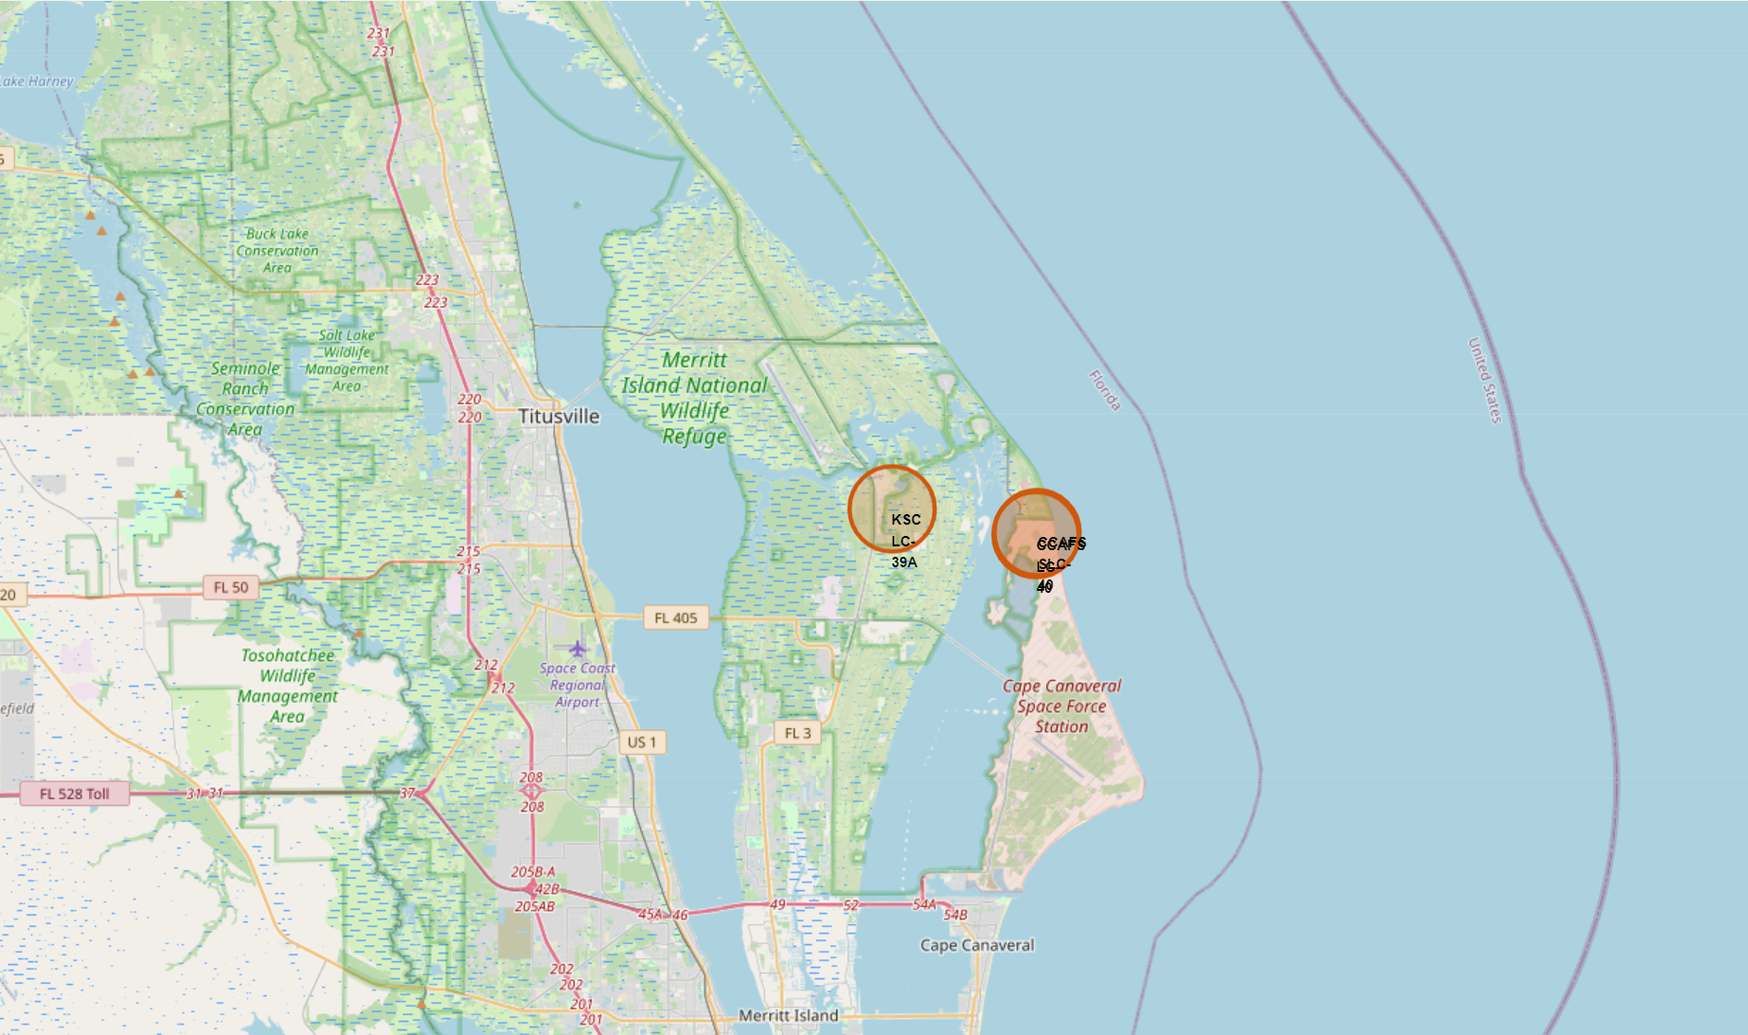
Ubicating Launch Sites on the map
First we ubicate the launch sites on the map using circles form and identify them by their name

Slide 36
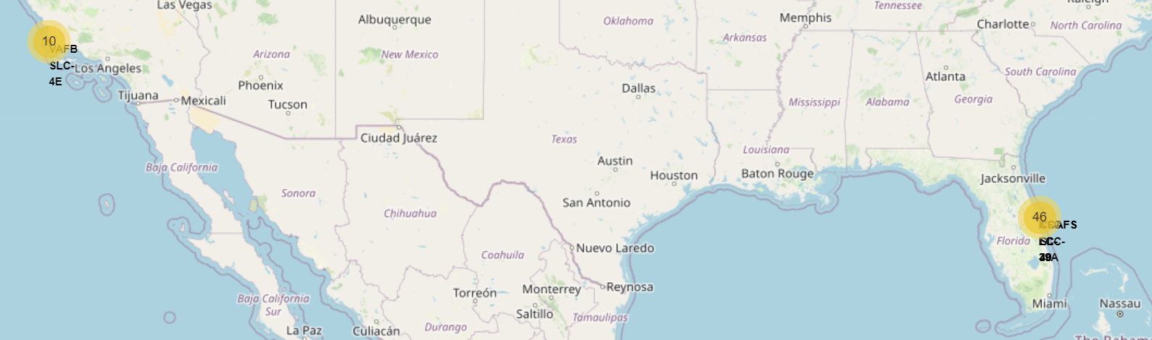
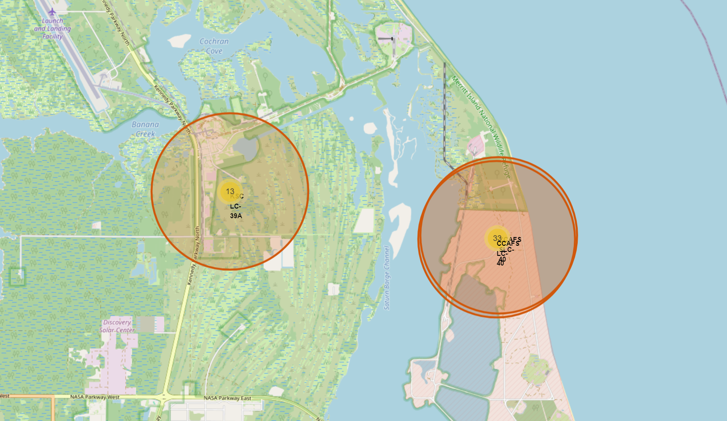
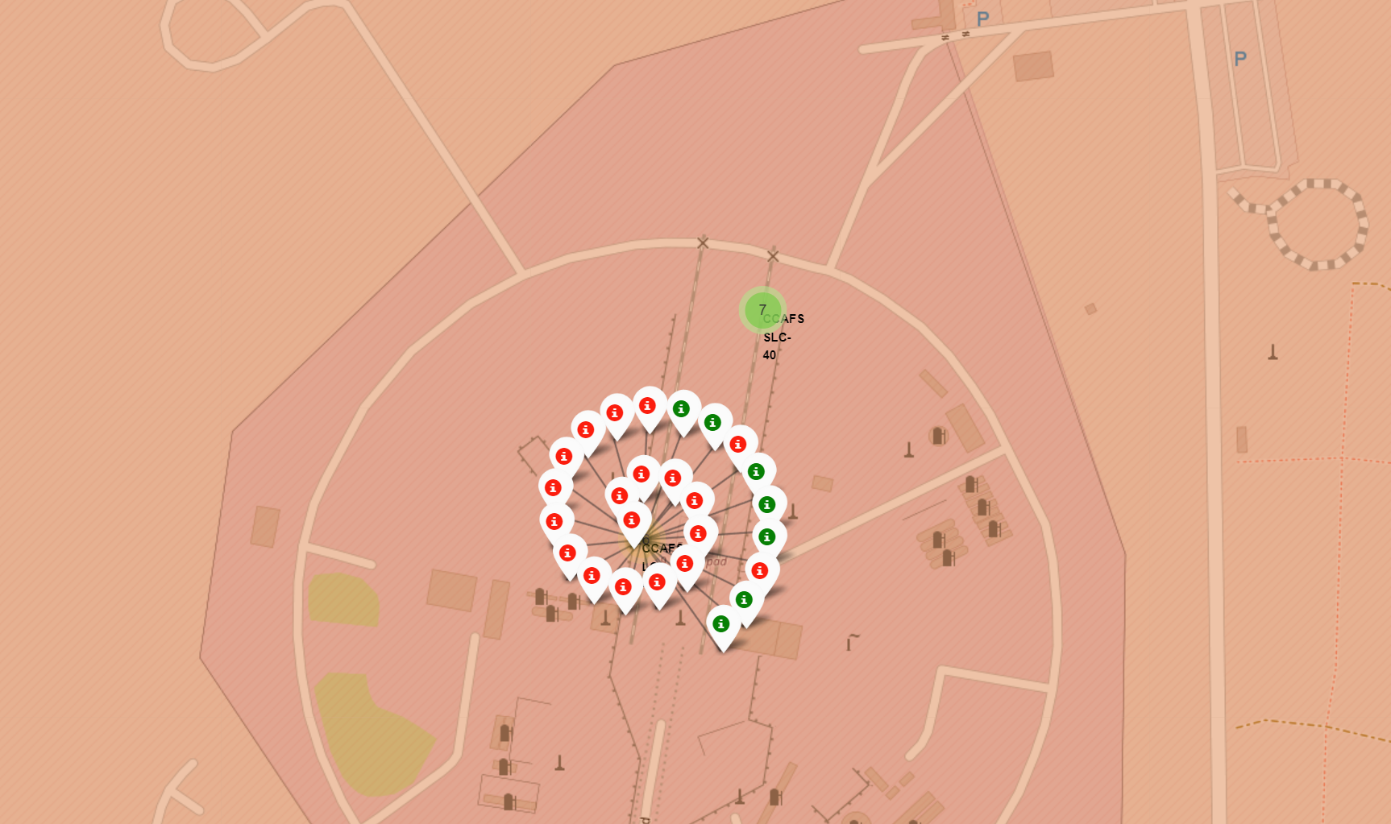
Mark the successful and failed launches
Then, we mark the sites with the successful launches with green marker, and failed launches with the red color.

Slide 37
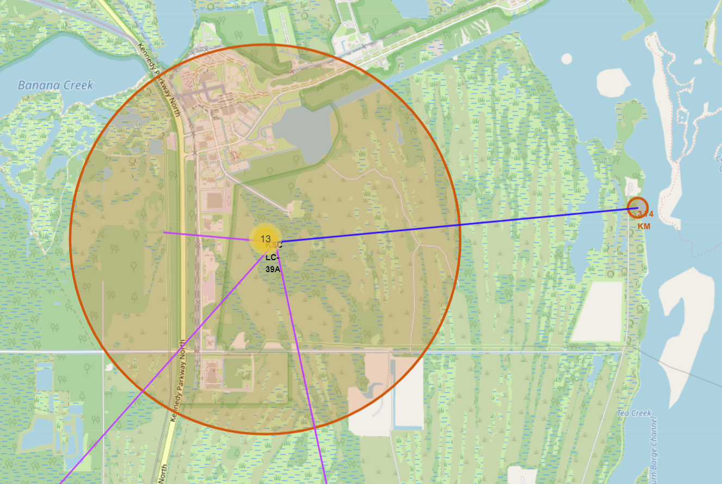
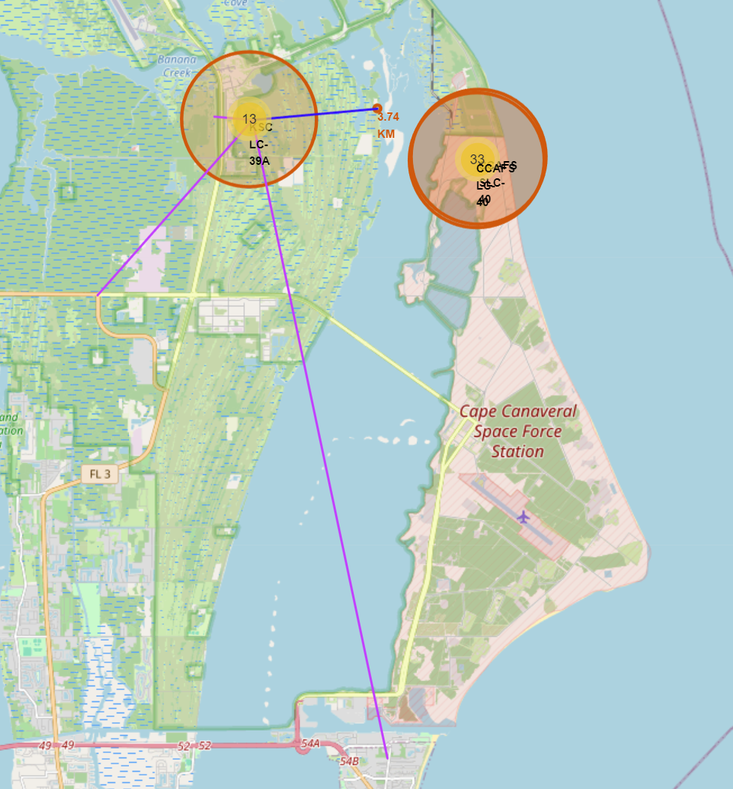
Launch proximities
Finally, we ubicate the launch proximities like the coast, railway, highway and the coastline, and draw a line between an any launch site to them.

Slide 38

Section 4

Slide 39
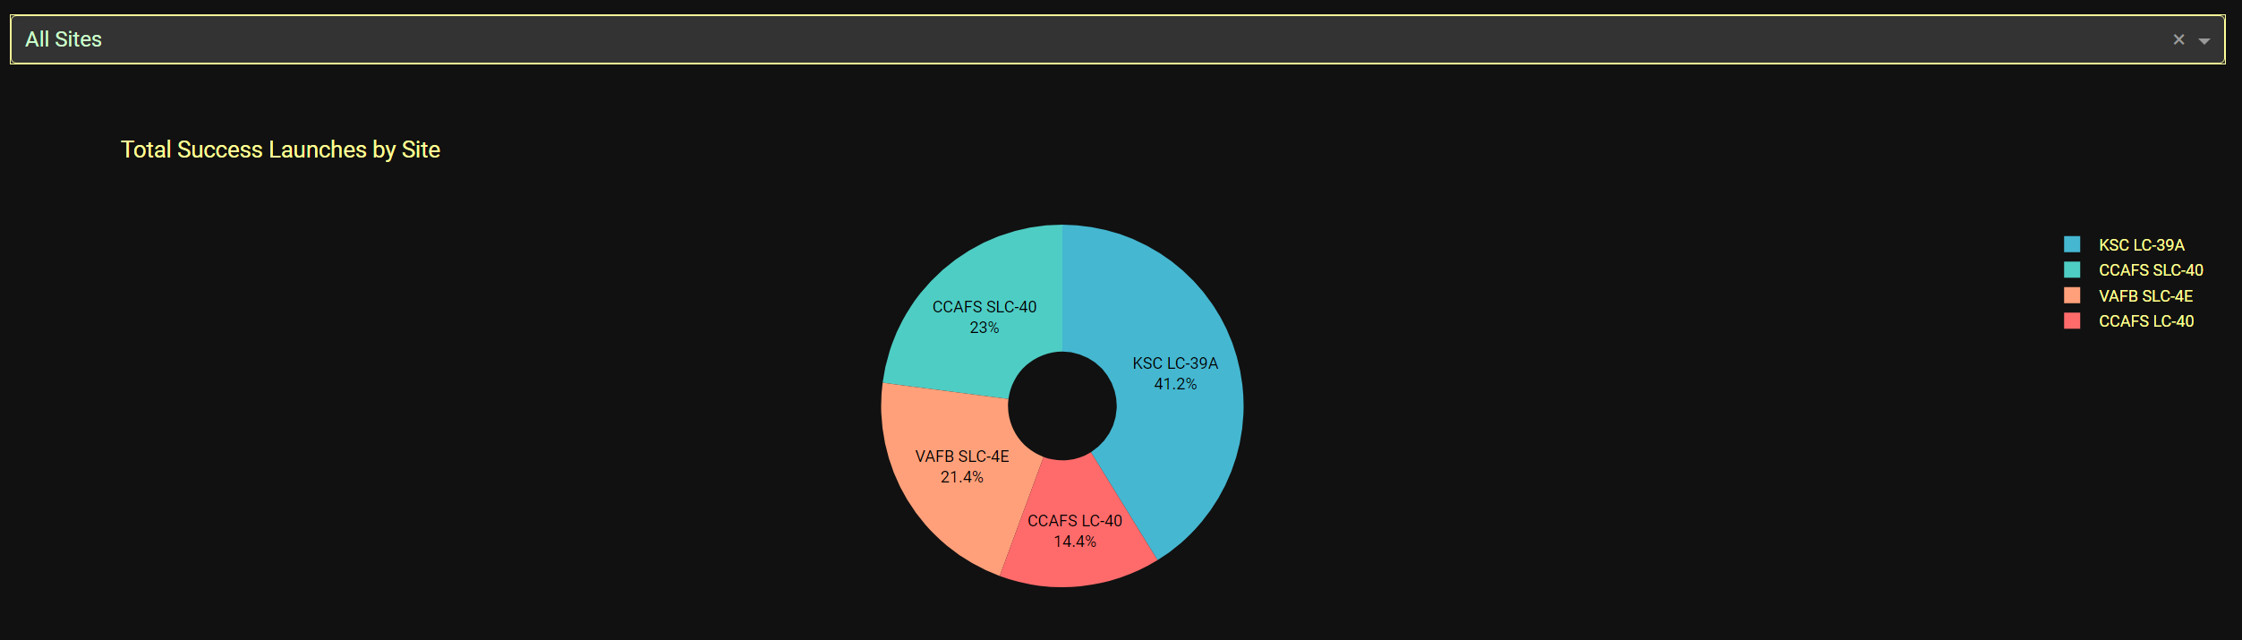
Launch Sites Pie Chart
KSC LC-39A is the best site with the 412% of successful landing

Slide 40
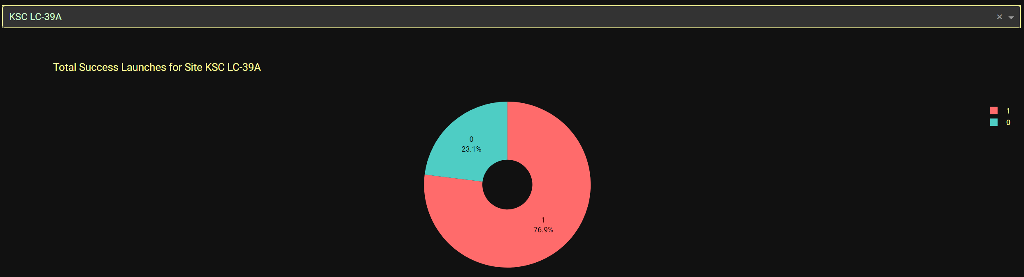
Pie Chart of KSC LC-39A
For KSC LC-39A has the 76.9% of successful landing

Slide 41
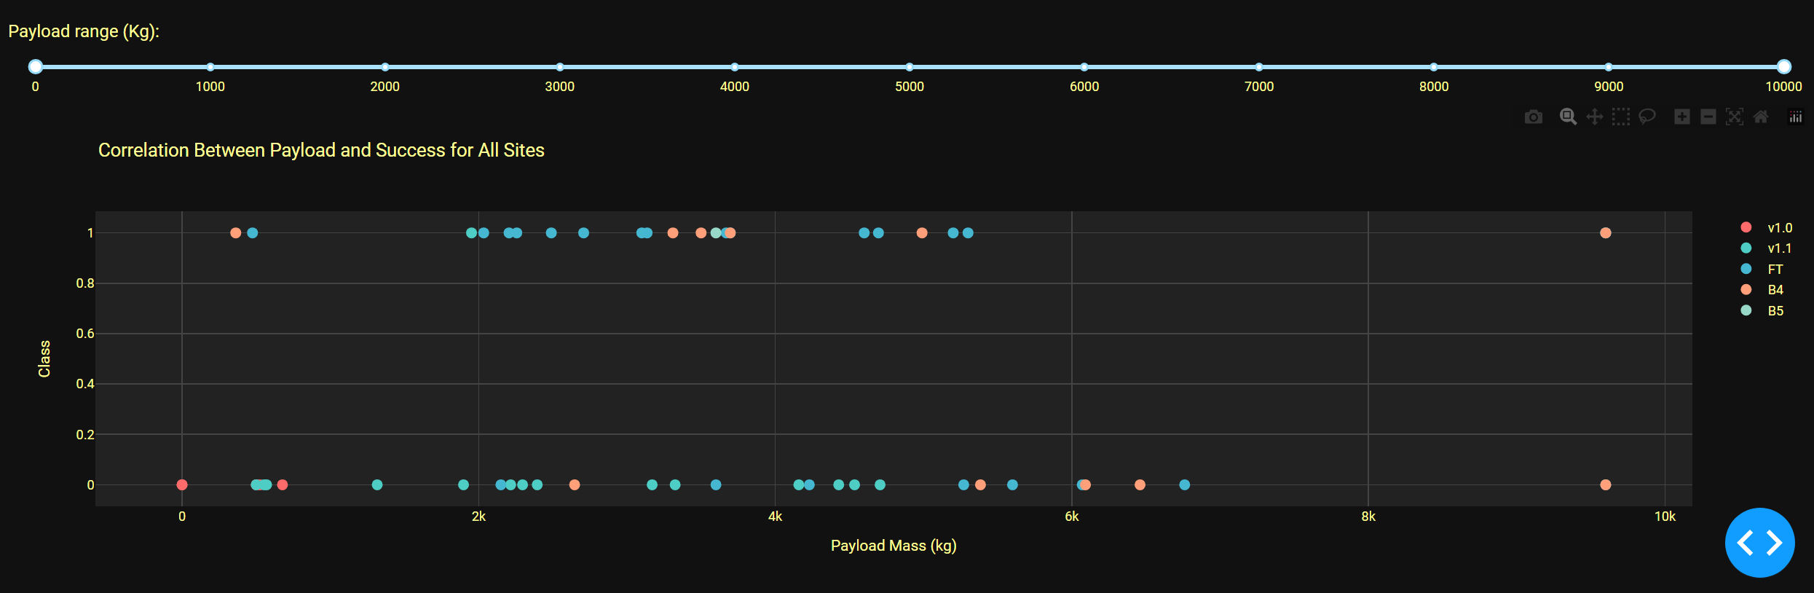
Payload Mass vs. Launch Outcome
FT is the best boost version for lower values of Payload Mass for all range, and V1.1 has the worst

Slide 42

Section 5

Slide 43
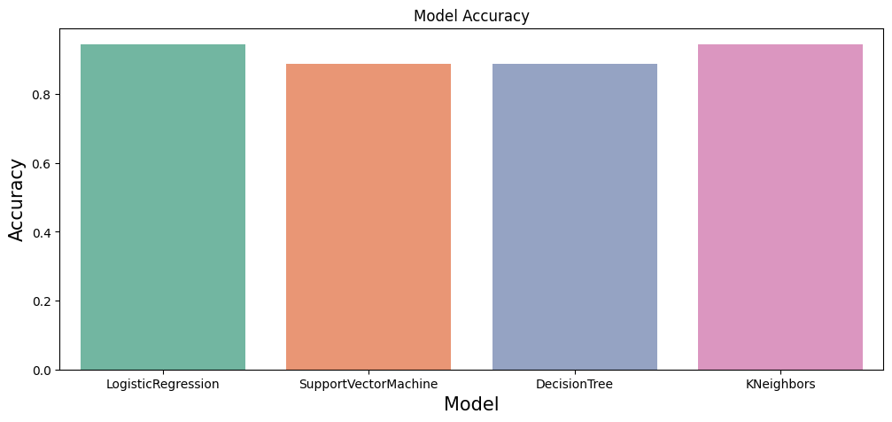
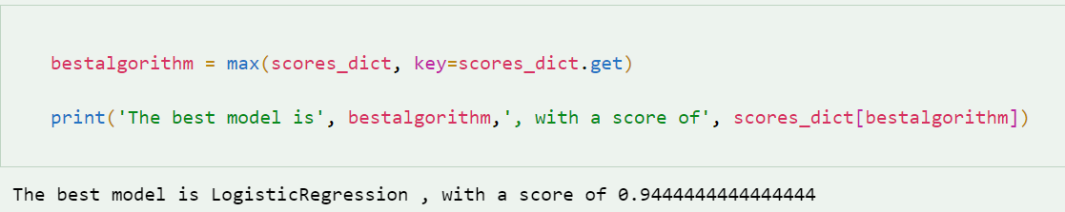
Classification Accuracy

Slide 44
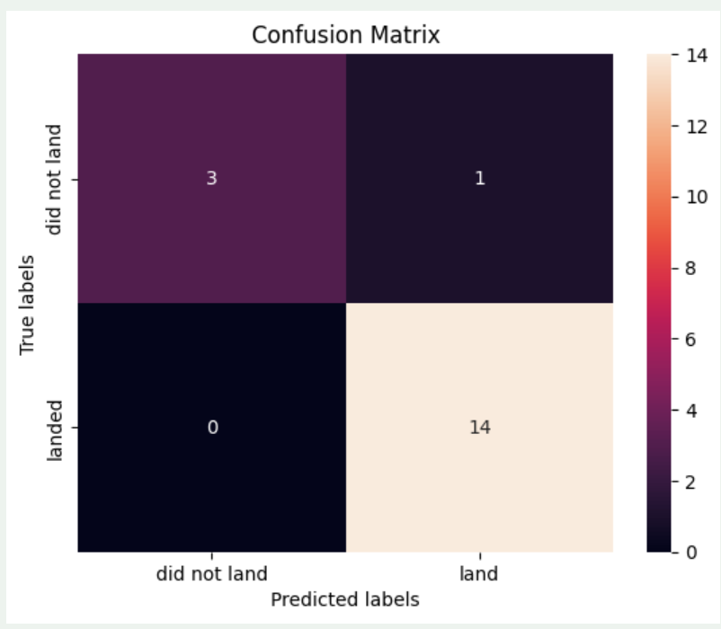
Confusion Matrix
Examining the confusion matrix, we see that logistic regression can distinguish between the different classes. We see that the major problem is false positives.

Slide 45
Conclusions
The main features that influence successful landing are Launch site, Payload mass, booster version, and Orbit. This one is the external factor that can affect the landing outcome. The success rate since 2013 kept increasing till 2020.
The orbits with the high number of success landing are VLEO and SSO.
Launch site KSC LC-39A has the best successful landing.
The best model for prediction is Logistical Regression and we can determine the landing outcome with 94.44% of accuracy.

Slide 46
Appendix
Data folder: https://github.com/demarquezs/IBM_DS_Capstone_Project/tree/master/data
Notebooks folder: https://github.com/demarquezs/IBM_DS_Capstone_Project/tree/master/notebooks
Saved model folder: https://github.com/demarquezs/IBM_DS_Capstone_Project/tree/master/models

Slide 47


